Slide 1
Data Mining Project 1
Jeff Wood
Ethan Bowen

Slide 2
Algorithms
K-nearest neighbors
Training and Classification on based on variable K, where K is identified by the number of nearest neighbors (points).
Centroid
Average of all points in a classification.
Linear Regression
Fitting a line or plane in a feature space in an attempt to determine the best class indicators.

Slide 3
Algorithms (Cont)
We tested the algorithms against 2-dimensional features.
The data sets included 46-dimensional feature vectors.
Can these algorithms handle N-dimensional vector spaces?!
Here is some examples of what our algorithms look like on 2-dimensional features.

Slide 4
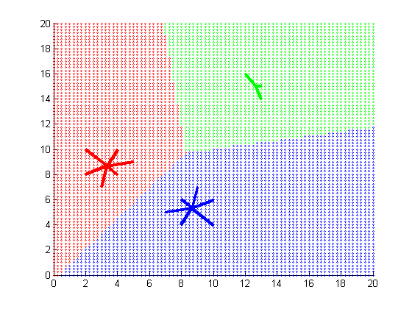
Results – Linear Regression

Slide 5
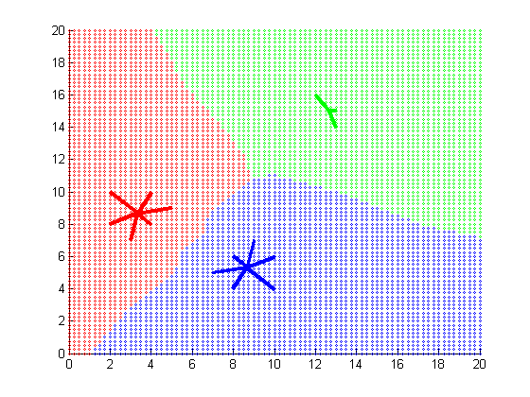
Results – K-nearest Neighbors (k=3)

Slide 6
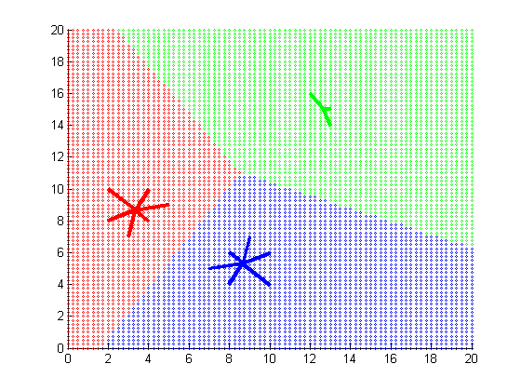
Results – Centroid

Slide 7
Data
Feature Vector
2-dimensional in previous examples
46-dimensional in provided data
ATNT50:
45 training data points
5 classes
5 images to classify
ATNT200:
180 training data points
20 classes
20 images to classify

Slide 8
ANTN50 Results
Centroid
100% classified correctly
Linear Regression
100% classified correctly

Slide 9
ANTN50 Results (Cont)

Slide 10
ANTN200 Results
Centroid
100% classified correctly
Linear Regression
100% classified correctly

Slide 11
ATNT200 Results (Cont)

Slide 12
Demo

